Slide 1
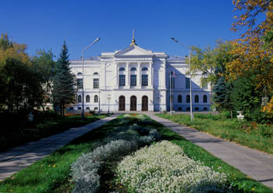
Health Psychology Laboratory
Head of Laboratory:
Prof. Natalia V. Kozlova, Dr. Sc. (Developmental Psychology)

Slide 2
Research Project “Health Psychology Laboratory”
Goals:
studying neurophysiological, psychophysiological, cognitive and axiological aspects of health as a person’s resource and strategic potential ensuring one’s stability and well-being, competitiveness and career longevity
developing advanced therapeutic technologies based on the project outcomes
developing the Russian health research database for sharing across international interdisciplinary research projects

Slide 3
Scientific background for studying health psychology and life quality problems at Psychology Faculty:
1999 – foundation of Genetic and Clinical Psychology Department;
2003 – foundation of Psychotherapy and Psychological Counseling Department;
2005 – receiving a status of Scientific School “Psychology of personality in norm and pathology”;
since 2002 – organization of international and all-Russian scientific events, including 8 Siberian psychological forums;
since 1999 – section in Siberian Psychological Journal – “Clinical Psychology and Health Psychology”;
since 1999 – Dr. Sc. and Cand. Sc. dissertations on problems of health psychology and life quality; more than 30;
2010 – starting master’s program in health and safety psychology;
1999-2014 – research projects studying health psychology and life quality problems, supported by RFH, RFFR, FEA and FTP; more than 20;
1999-2014 – publication of about 70 articles on health and safety psychology problems in peer-reviewed journals including those indexed in Web of Science and Scopus.

Slide 4
Health Psychology Laboratory staff’s research competence
Experience of research, scientific, educational and innovation activity concerned with health psychology and life quality.
Strategies of cross-cultural and interdisciplinary research focusing on different aspects of health as a person’s resource and strategic potential.
Electronic research database on health as a person’s social quality ensuring one’s competitiveness under market economy conditions, family well-being and career longevity as well as enhancing one’s life quality.
Experience of developing express-methods for evaluating people’s psychological and physical state and developing therapeutic technologies.
Experience of developing and implementing medico-socio-psychological rehabilitation programs.
Human resource including scientists being involved in international research projects as well as scientists awarded the Honored Master of Science title.
Research tools of investigating health and safety psychology and life quality problems: diagnostic packages; statistic packages (Statistica, SPSS); program apparatus diagnostic packages; Social Psychology Laboratory; Psychological Assessment Laboratory; Psychophysiology Laboratory; Socio-Psychological Education Center .

Slide 5
Collaboration with Russian and international research teams in the field of health and safety psychology and life quality problems (based on cooperation agreements):
SBEI HPE “Krasnoyarsk State Medical University named after Prof. V. F. Voyno-Yasenetsky”;
SBEI HPE “Ural State Medical University” of RF Ministry of Healthcare;
FSFRI “Tomsk Research Institute of Balneology and Physiotherapy” of Federal Medico-Biological Agency;
FSFI “Research Institute of Physiology and Fundamental Medicine” of Siberian Branch of Russian Academy of Sciences;
FSFI “ Mental Health Research Institute” of Siberian Branch of Russian Academy of Medical Sciences;
RSAHI “Children’s Municipal Hospital №1”;
Tomsk regional non-profit fund “Tomsk – Anti-AIDS”;
PMPTF “Maternity Hospital named after N. A. Semashko”;
RSFHI “Tomsk Mental Clinic Hospital”;
Medicine and Psychology Faculty of Sapienza University of Rome, Italy;
Psychology and Counseling Department of Marywood University, PA, USA;
Education Faculty of Haifa University, Israel;
Psychological Science and Education Faculty, Cognition and Neurosciences Research Centre, Université Libre de Bruxelles, Brussels, Belgium.

Slide 6
Expected outcomes:
Russian electronic database of neurophysiological, psychophysiological, cognitive and social parameters of health.
Variant (depending on climatic, political, socio-economic, ethnic and socio-cultural factors ) and invariant parameters determining a new understanding of health and its value as a person’s resource and strategic potential.
Involvement in international interdisciplinary health research projects focusing on health etiology from the contemporary psychological perspective.
New approaches to cross-cultural and interdisciplinary research aimed at identifying neuropsychological, psychophysiological, cognitive and axiological aspects of health.
Psychoprophylactic programs for employees working under a rotation system in circumpolar regions.
Advanced complex socio-cognitive rehabilitation technologies for health protection.
Person-oriented programs aimed at diagnostics, prophylaxis, rehabilitation and correction of cognitive impairments as well as employee efficiency maintenance, career longevity enhancement, disease risk reduction and life quality improvement: “Cognitive impairments”; “Ischemic heart disease – a new life quality”; “Stress-free life”; “Schoolchildren’s psychological health”; “Psychological aspects of somatic diseases”; “A way to health”.

Slide 7
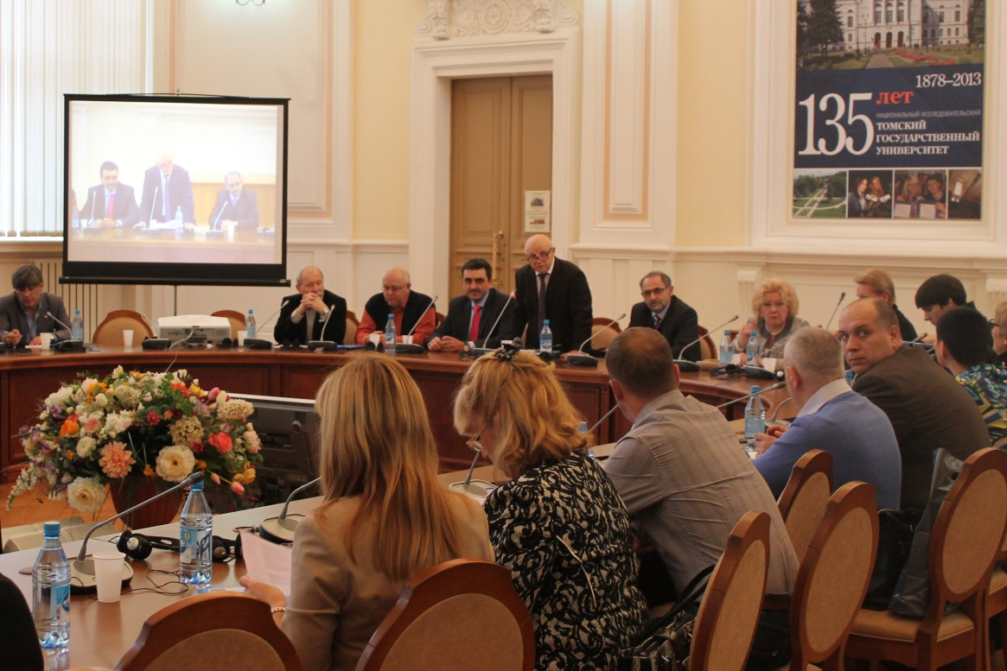
Health Psychology Laboratory

